Slide 1


fhu3213 analisis kewangan industri perkayuan
SUCHEE OPERATION PTE LDT
JAMHURI JAMALUDDIN 1619XX
MUHAMMAD HANIF BIN GHAZALI 164178
SHAHIDATUL HUSNA BINTI SUNGIB 162994
NANCY ANAK ADOH 161319
NORLIYANA BT AHMAD SHUKRI 165410
AHMAD AIMAN BIN AHMAD JIHADUDDIN 170805
Universiti Putra Malaysia

Slide 2
Company Background
Company name : SUCHEE OPERATION PTE LTD
Address : Universiti Putra Malaysia,
43400, Serdang,
Selangor, Malaysia
Date started : 17th February 2012
Types of bussines : Provide services for forest operation
Initial capital : RM 98,000.00
No of Boards : 6 person
of Directors
Field : Contract on forest operations
Email : info@sucheeoperation.com
Contact no : 03-3456789

Slide 3
Organization Chart
JAMHURI JAMALUDDIN [CHIEF DIRECTORS]
MUHAMMAD HANIF
[ASST. DIRECTOR I]
NORLIYANA A. SHUKRI
[H.R. EXECUTIVES]
NANCY ADOH
[FINANCE EXECUTIVES]
SHAHIDATUL HUSNA
[ASST. DIRECTOR II]
AHMAD AIMAN
[SALES EXECUTIVES]

Slide 4
FINANCIAL STATEMENT
BALANCE SHEET
INCOME STATEMENT
EQUITY
CASH FLOW

Slide 5
SUCHEE OPERATION PTE LTD
BALANCE SHEETS
DECEMBER 31, 2012 AND 2013
 |  |  | 2013 |  | 2012
CURRENT ASSETS
 | Cash |  | RM 554,000 |  | RM 98,000
 | Certificate of deposit |  | 550,000 |  | 550,00
 | Account receivable- trade, net |  | 6,318,000 |  | 6,809,000
 | Account receivable- other |  | 30,000 |  | 39,000
 | Costs and estimated earnings in excess of billings on uncompleted contracts |  | 104,000 |  | 110,000
 | Inventory |  | 1,074,000 |  | 1,238,000
 | Prepaid expenses |  | 492,000 |  | 269,000
 | Total current assets |  | 9,122,000 |  | 9,113,000
FIXED ASSETS
 | Property and Equipment, Net |  | 2,971,000 |  | 3,229,00
 | Total assets |  | RM 12,093,000 |  | RM 12,342,000

Slide 6
SUCHEE OPERATION PTE LTD
BALANCE SHEETS-cont.
DECEMBER 31, 2012 AND 2013
LIABILITIES AND OWNERS’ EQUITY
 |  |  | 2013 |  | 2012
CURRENT LIABILITIES
 | Current maturities of long-term debt |  | RM 1,650,000 |  | RM 1,698,000
 | Account payable- trade |  | 3,217,500 |  | 3,052,000
 | Billings in excess of costs and estimated earnings of on uncompleted contracts |  | 177,000 |  | 116,000
 | Income tax payable |  | 396,638 |  | 58,000
 | Accrued liabilities |  | 131,000 |  | 99,000
 | Deferred income taxes |  | 1,518,530 |  | 1,538,000
 | Total current liabilities |  | 7,090,410 |  | 6,561,000
LONG-TERM LIABILITIES
 | Long-term debt, less current maturities |  | 478,000 |  | 1,171,000
 | Deferred income taxes |  | 332,280 |  | 852,000
 | Total long-term liabilities |  | 810,280 |  | 2,023,000
 | Total current liabilities + long-term liabilities |  | 7,900,690 |  | 8,584,000
OWNERS’ EQUITY
 | Common stock Authorized 500,000 shares, RM10 par value, 19,500 shares issued, 15,300 shares outstanding |  | 195,000 |  | 195,000
 | Additional paid-in capital |  | 431,000 |  | 431,000
 | Retained earnings |  | 3,820,310 |  | 3,386,000
 | Treasury stock (4,200 shares at cost) |  | 4,446,310 (254,000) |  | 4,012,000 (254,000)
 | Total owners’ equity |  | 4,192,310 |  | 3,758,000
 | Total liabilities + owner’s equity |  | RM 12,093,000 |  | RM 12,342,000

Slide 7
SUCHEE OPERATION PTE LTD
STATEMENTS OF EARNINGS
YEARS ENDED DECEMBER 31, 2013 AND 2012
 |  | 2013 |  |  |  | 2012
 |  | Amount |  | Percent of Revenue |  | Amount |  | Percent of Revenue
REVENUE |  | RM 66,384,000 |  | 100.00 | % | RM 67,176,000 |  | 100.00 | %
CONTRACT COSTS |  | 60,087,000 |  | 90.51 |  | 59,932,000 |  | 89.22
Gross profit |  | 6,297,000 |  | 9.49 |  | 7,244,000 |  | 10.78
GENERAL AND ADMINISTRATIVE EXPENSES |  | 535,000 |  | 8.07 |  | 5,955,000 |  | 8.86
Operating profit |  | 942,000 |  | 1.42 |  | 1,289,000 |  | 1.92
OTHER INCOME (EXPENSE)
Customer finance charges |  | 19,000 |  |  |  | 14,000
Miscellaneous income |  | 10,500 |  |  |  | 4,000
Gain on sale of assets |  | 63,000 |  |  |  | 12,000
Interest income |  | 37,000 |  |  |  | 34,000
Interest expense |  | (325,000) |  |  |  | (386,000)
Total other income (expense) |  | (195,500) |  | (0.29) |  | (322,000) |  | (0.48)
Earnings before Income tax expense |  | 746,500 |  | 1.13 |  | 967,000 |  | 1.44
INCOME TAX EXPENSE |  | 312,190 |  | 0.46 |  | 405,400 |  | 0.43
NET EARNINGS |  | RM 434,310 |  | 0.67 | % | RM 561,600 |  | 1.01 | %

Slide 8
SUCHEE OPERATION PTE LTD
STATEMENTS OF OWNER’S EQUITY
YEARS ENDED DECEMBER 31, 2013 AND 2012
 |  | Common Stock |  | Additional Paid-In Capital |  | Retained Earnings
BALANCE 1-1-2012 |  | RM 195,000 |  | RM 431,000 |  | RM 2,824,000
Net earnings |  |  |  |  |  | 561,600
BALANCE 12-31-2012 |  | 195,000 |  | 431,000 |  | 3,386,000
Net earnings |  |  |  |  |  | 434,310
BALANCE 12-31-2014 |  | RM 195, 000 |  | RM 431,000 |  | RM 3,820,310

Slide 9
SUCHEE OPERATION PTE LTD
STATEMENTS OF CASH FLOWS
YEARS ENDED DECEMBER 31, 2013 AND 2012
 |  |  | 2013 |  | 2012
OPERATING ACTIVITIES
 | Net earnings |  | RM 434,310 |  | RM 511,600
 | Adjustment to reconcile net earnings to net cash provided by operating activities:
 | Depreciation |  | 1,147,000 |  | 1,097,000
 | Gain on sale of assets |  | (63,000) |  | (12,000)
 | Change in allowance for doubtful accounts |  |  |  | 75,000
 | Change in deferred income taxes |  | (539,190) |  | 14,000
 | (Increase) decrease in:
 | Accounts receivable - trade |  | 491,000 |  | 2,075,000
 | Accounts receivable - other |  | 9,000 |  | 10,000
 | Costs and estimated earnings in excess of billings on uncompleted contracts |  | 6,000 |  | 415,000
 | Inventory |  | 164,000 |  | 248,000
 | Prepaid expenses |  | (223,000) |  | 106,400
 | Increase (decrease):
 | Account payable - trade |  | 165,500 |  | (1,774,000)
 | Billings in excess of costs and estimated earnings on uncompleted contracts |  | 61,000 |  | (431,000)
 | Federal income tax payable |  | 338,380 |  | 58,000
 | Accrued liabilities |  | 32,000 |  | (312,000)
 | NET CASH PROVIDED BY OPERATING ACTIVITIES |  | RM 2,023,000 |  | RM 2,081,000

Slide 10
SUCHEE OPERATION PTE LTD
STATEMENTS OF CASH FLOWS - continued
YEARS ENDED DECEMBER 31, 2013 AND 2012
 |  |  | 2013 |  | 2012
INVESTING ACTIVITIES
 | Proceeds from sale of assets |  | 145,000 |  | 30,000
 | Purchase of property and equipment |  | (776,000) |  | (753,000)
 | NET CASH USED IN INVESTING ACTIVITIES |  | (631,00) |  | (723,000)
FINANCING ACTIVITIES
 | Proceeds from issuance of long-term debt |  | 420,000 |  | 4,334,000
 | Reduction of long-term debt |  | (1,356,000) |  | (5,644,000)
 | NET CASH USED IN FINANCING ACTIVITIES |  | (936,000) |  | (1,310,000)
 | NET INCREASE IN CASH |  | 456,000 |  | 48,000
 | Cash at the beginning of year |  | 98,000 |  | 50,000
 | Cash at the end of year |  | RM 554,000 |  | RM 98,000

Slide 11
RATIO ANALYSIS
LIQUIDITY
EFFICIENCY
LEVERAGE
PROFITABILITY
Du Pont SYSTEM

Slide 12
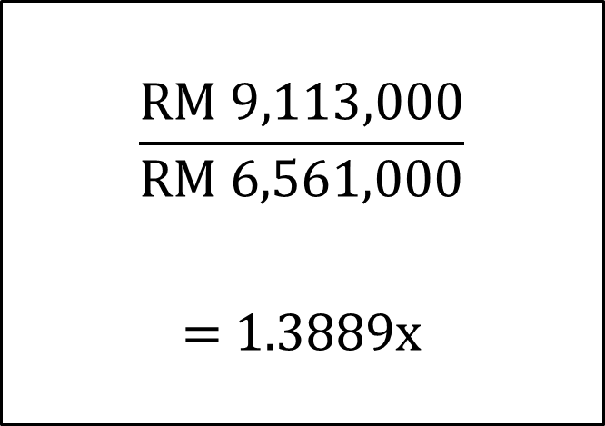
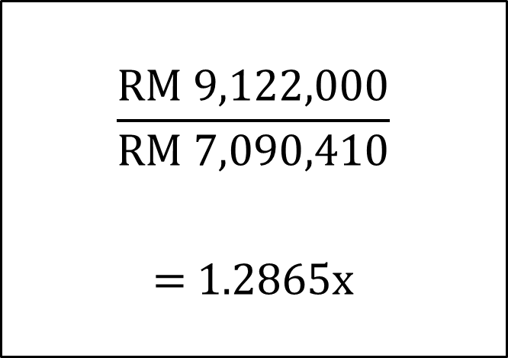

Liquidity Ratio
Current ratio = $\frac{Current assets}{Current liabilities}$
2013
2012
$$\frac{RM 9,122,000}{RM 7,090,410}$$
= 1.2865x
$$\frac{RM 9,113,000}{\text{RM} \text{6,561,000}}$$
= 1.3889x

Slide 13
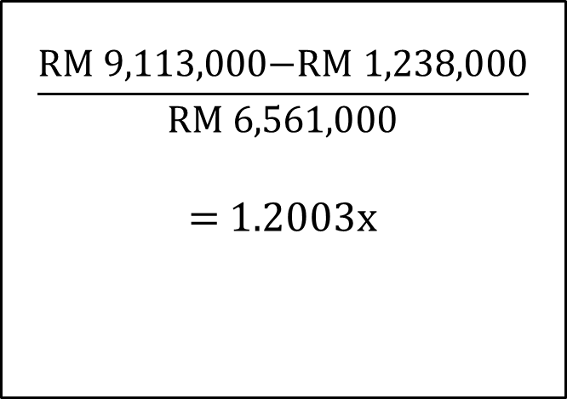
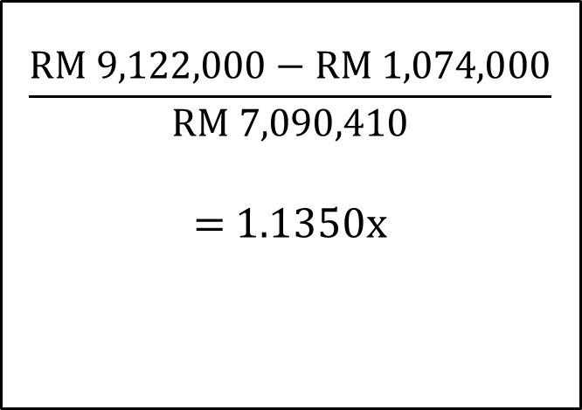
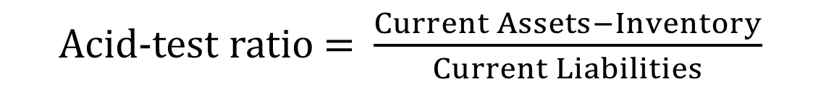
Liquidity Ratio
Acid-test ratio = $\frac{Current Assets−Inventory}{Current Liabilities}$
2013
2012
$$\frac{RM 9,122,000−\text{RM} \text{1,074,000}}{RM 7,090,410}$$
= 1.1350x
$$\frac{\text{RM}\text{ 9,113,000−}\text{RM} \text{1,238,000}}{\text{RM} \text{6,561,000}}$$
= 1.2003x

Slide 14
Summary on Liquidity Ratio
Ratio | 2013 | 2012
Current ratio | 1.2865x | 1.3889x
Acid-test ratio | 1.1350x | 1.2003x
Current ratio rules of thumb is 1.5 or 2.0 to be comfortable
  But Suchee Operation ratio are below 1.5 which means that it might have little problem for coverage to short-term creditors
Acid Test shows that ratio for both years is above 1.0
  Suchee operation able to meet its short-term obligations without its inventories being liquidated.

Slide 15
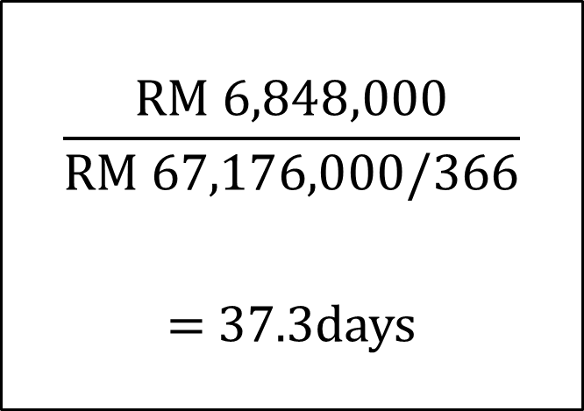
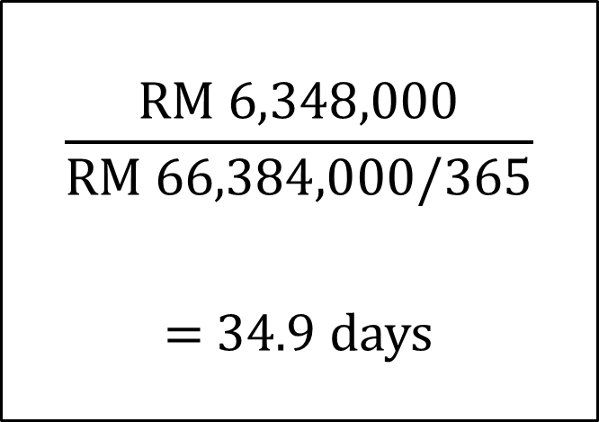
Efficiency Ratio
Average collection period = $\frac{Account receivable}{Daily credit sales}$
2013
2012
$$\frac{RM 6,348,000}{\text{RM} \text{66,384,000}/365}$$
= 34.9 days
$$\frac{\text{RM}\text{ 6,84}8,000}{\text{RM} \text{67,176,000}/366}$$
= 37.3days

Slide 16
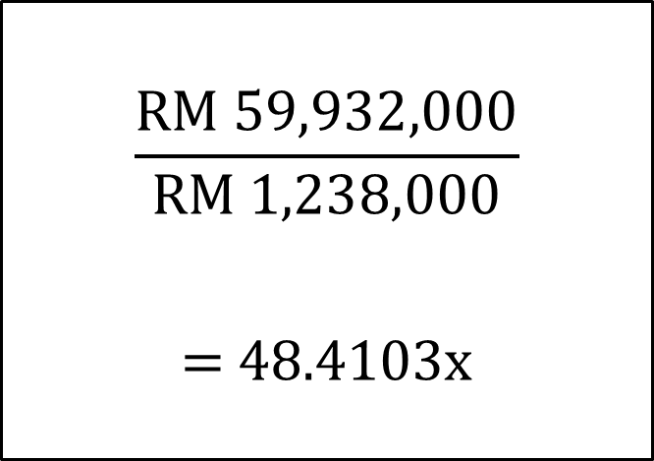
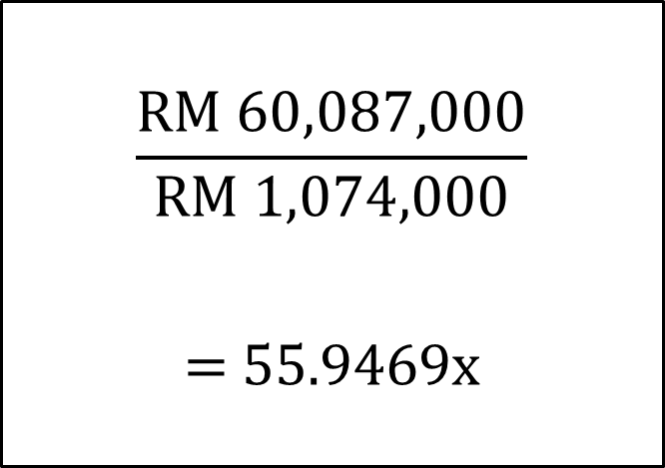
Efficiency Ratio
Inventory Turnover Ratio = $\frac{Cost of goods sold}{Inventory}$
2013
2012
$$\frac{RM 60,087,000}{RM 1,074,000}$$
= 55.9469x
$$\frac{RM 59,932,000}{\text{RM} \text{1,238,000}}$$
= 48.4103x

Slide 17
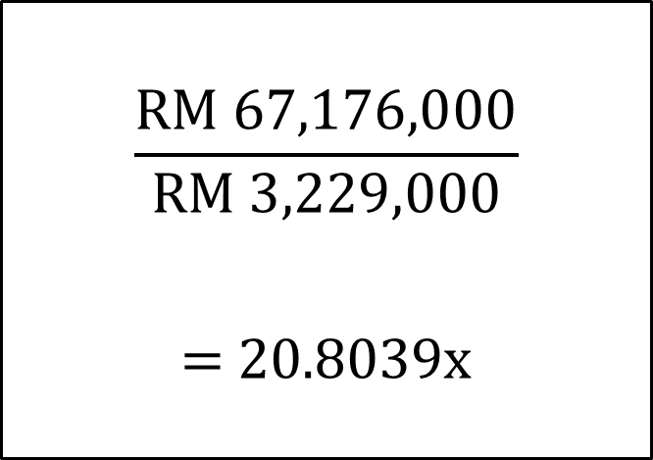
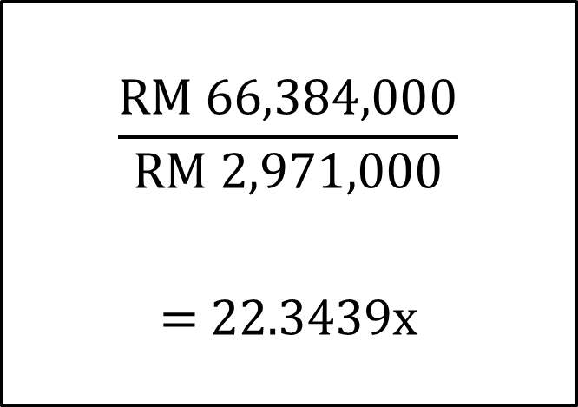
Efficiency Ratio
Fixed Assets Turnover Ratio = $\frac{Sales}{Net fixed assets}$
2013
2012
$$\frac{\text{RM} \text{66,384,000}}{RM 2,971,000}$$
= 22.3439x
$$\frac{\text{RM} \text{67,176,000}}{RM 3,229,000}$$
= 20.8039x

Slide 18
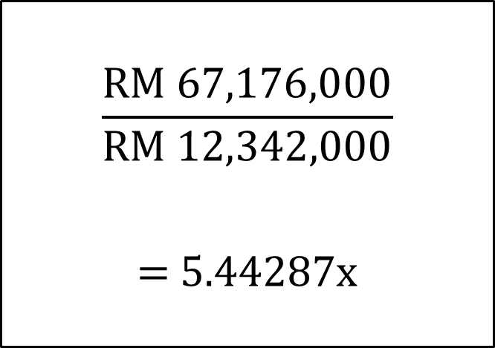
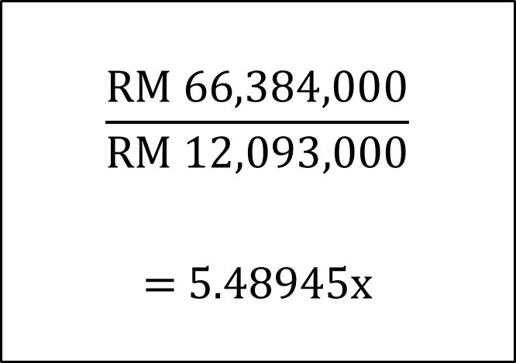
Efficiency Ratio
Total Assets Turnover Ratio = $\frac{Sales}{Total assets}$
2013
2012
$$\frac{\text{RM} \text{66,384,000}}{RM 12,093,000}$$
= 5.48945x
$$\frac{\text{RM} \text{67,176,000}}{RM 12,342,000}$$
= 5.44287x

Slide 19
Summary on Efficiency Ratio
Ratio | 2013 | 2012
Ave. collection period | 34.9 days | 37.3 days
Inventory turnover ratio | 55.9469x | 48.4103x
Fixed asset turnover ratio | 22.3439x | 20.8039x
Total assets turnover ratio | 5.48945x | 5.44287x
Average collection period is low because it has efficient sales collection policy and it help to improve the cash flow of the firm.
Inventory turnover ratio is too high which is detrimental might be due to customer’s order cannot be filled quickly or there are work stoppages because of inadequate supplies of raw material.
Fixed asset turnover ratio is high which indicates that it is using its fixed asset extensively to generate sales and profits.
Total assets turnover ratio

Slide 20
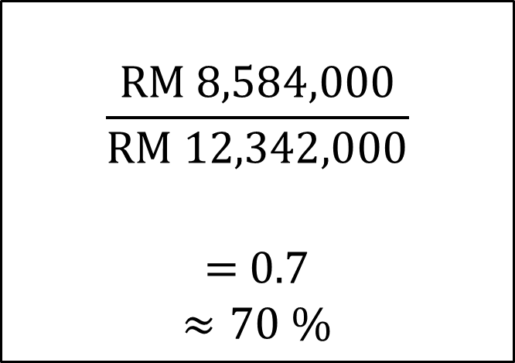
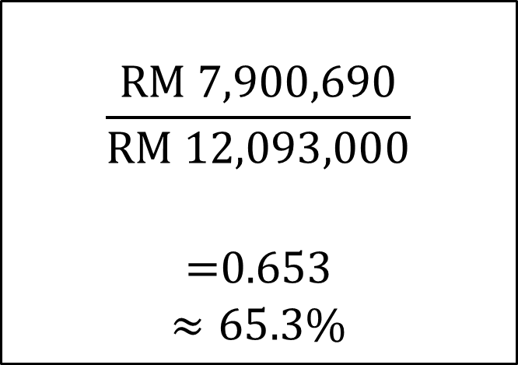
Leverage Ratio
Debt Ratio = $\frac{Total Liabilities}{Total Assets}$
2013
2012
$$\frac{RM 7,900,690}{\text{RM} \text{12,093,000}}$$
=0.653
$$≈65.3\%$$
$$\frac{\text{RM}\text{ 8,5}84,000}{\text{RM} \text{12,342,000}}$$
= 0.7
$$≈70 \%$$

Slide 21
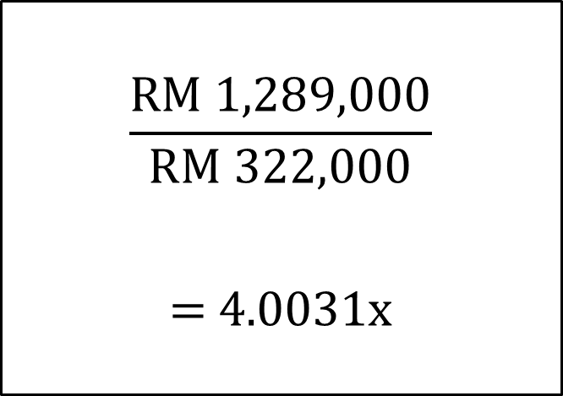
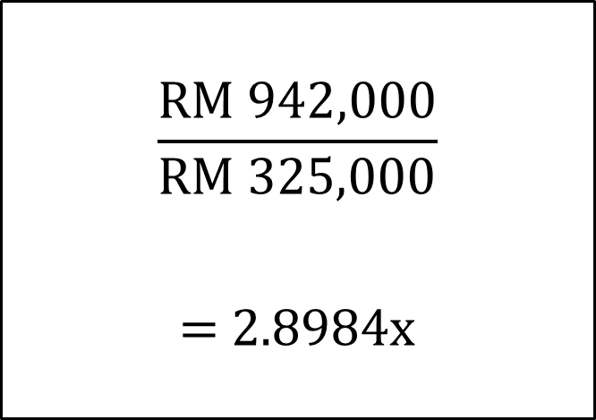
Leverage Ratio
Times Interest Earned Ratio = $\frac{Operating Income}{Interest Expense}$
2013
2012
$$\frac{RM 942,000}{\text{RM} \text{325,000}}$$
= 2.8984x
$$\frac{\text{RM}\text{ 1,289,000}}{\text{RM} \text{322,000}}$$
= 4.0031x

Slide 22
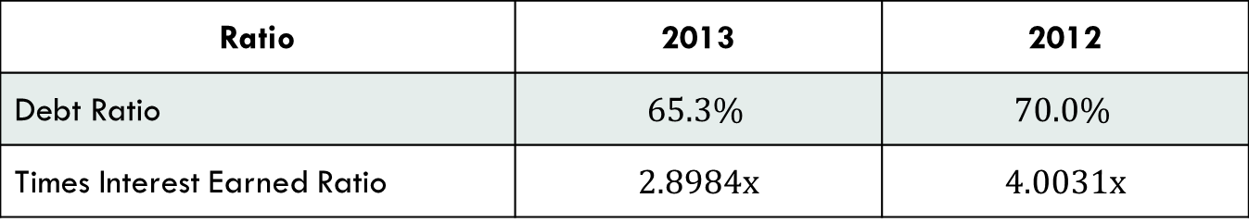
Summary Leverage Ratio
Ratio | 2013 | 2012
Debt Ratio | $$65.3\%$$ | $$70.0\%$$
Times Interest Earned Ratio | 2.8984x | 4.0031x
Debt Ratio value is more 0.5 means that half of the company's assets are financed through debts
  Higher portion of company's assets are claimed by it creditors,
  Higher risk in operation since the business would find it difficult to obtain loans for new projects.
Times interest earned ratio is very important from the creditors view point.
  Ratio of 2 or higher is considered adequate to protect the creditors’ interest in the firm

Slide 23
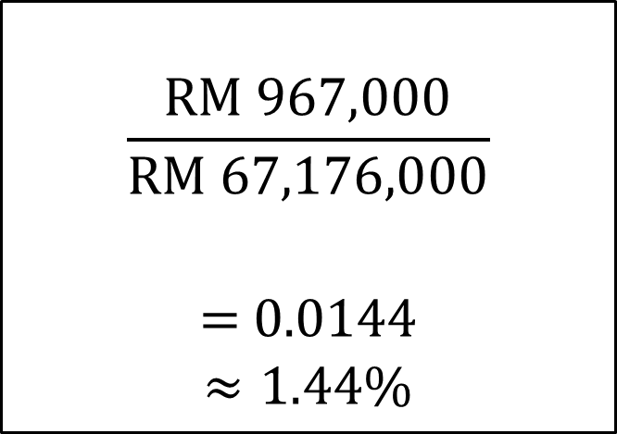
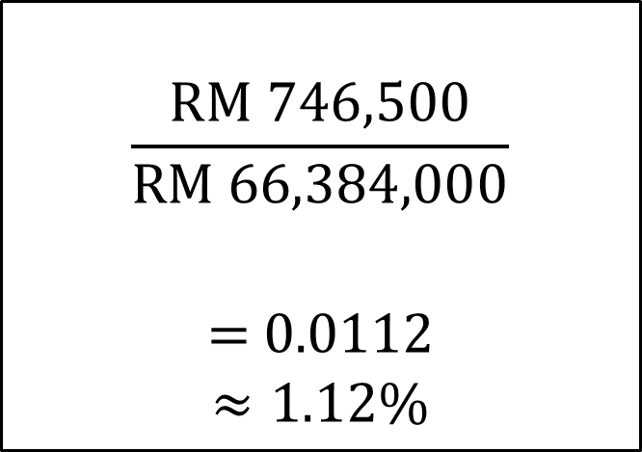
Profitability Ratio
Operating Profit Margin = $\frac{Operating Income}{Sales}$
2013
2012
$$\frac{RM 746,500}{\text{RM}\text{ 66,384,000}}$$
= 0.0112
$$≈1.12\%$$
$$\frac{RM \text{967,000}}{\text{RM}\text{ 67,176,000}}$$
= 0.0144
$$≈1.44\%$$

Slide 24
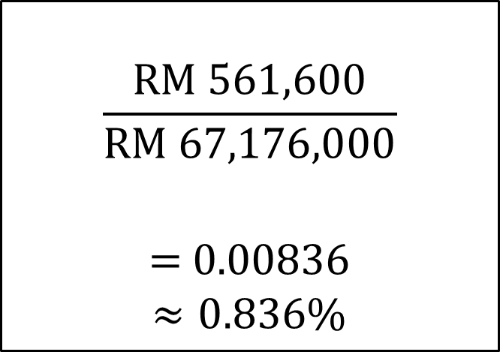
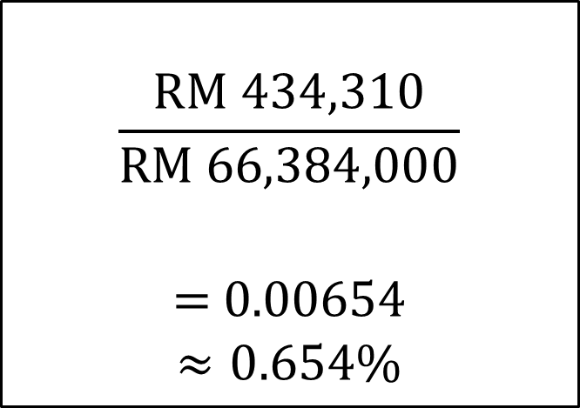
Profitability Ratio
Net profit margin = $\frac{Net Income}{Sales}$
2013
2012
$$\frac{RM 434,310}{\text{RM}\text{ 66,384,000}}$$
= 0.00654
$$≈0.654\%$$
$$\frac{RM 561,600}{\text{RM}\text{ 67,176,000}}$$
= 0.00836
$$≈0.836\%$$

Slide 25
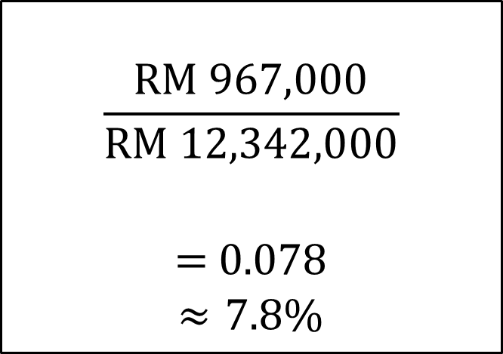
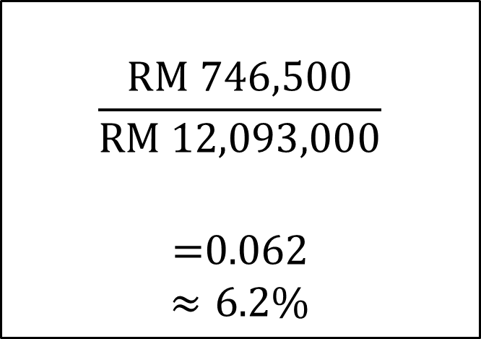
Profitability Ratio
Operating Income Return on Investment = $\frac{Operating Income}{Total Assets}$
2013
2012
$$\frac{RM 746,500}{\text{RM}\text{ 12,093,000}}$$
=0.062
$$≈6.2\%$$
$$\frac{RM \text{967,000}}{\text{RM}\text{ 12,342,000}}$$
= 0.078
$$≈7.8\%$$

Slide 26
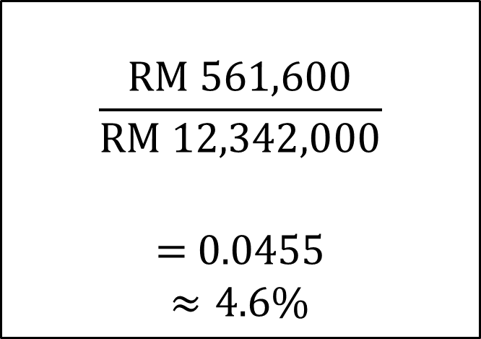
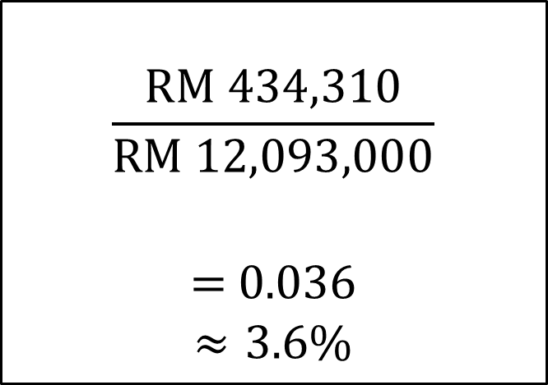
Profitability Ratio
Return on Assets = $\frac{Net Income}{Total Assets}$
2013
2012
$$\frac{RM 434,310}{\text{RM}\text{ 12,093,000}}$$
= 0.036
$$≈3.6\%$$
$$\frac{RM \text{561,600}}{\text{RM}\text{ 12,342,000}}$$
= 0.0455
$$≈4.6\%$$

Slide 27
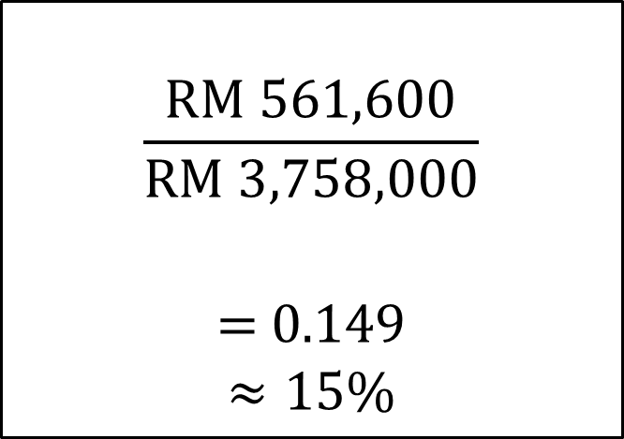
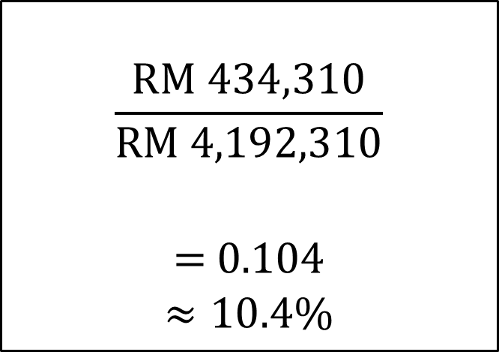
Profitability Ratio
Return on Equity = $\frac{Net Income}{Common Equity}$
2013
2012
$$\frac{RM 434,310}{RM \text{4,192,310}}$$
= 0.104
$$≈10.4\%$$
$$\frac{\text{RM}\text{ 561,600}}{\text{RM}\text{ 3},758,000}$$
= 0.149
$$≈15\%$$

Slide 28
Summary on Profitability Ratio
Ratio | 2013 | 2012
Operating Profit Margin | 1.12% | 1.44%
Net Profit Margin | 0.654% | 0.836%
Operating income ROI | 6.2% | 7.8%
Return On Asset | 3.6% | 4.6%
Return On Equity | 10.4% | 15%
During 2013, Suchee keeping operating cost down, but not as good as at total cost. The operating income ROI and ROA and ROE are all low mainly due to productivity problem

Slide 29
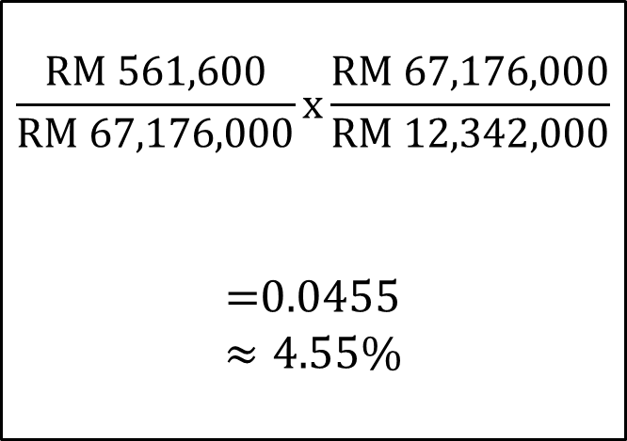
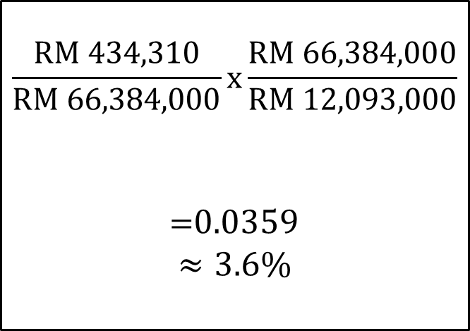
Du Pont System (RETURN ON ASSETS)
$\frac{Net Income}{Total Assets}$= $\frac{Net Income}{Sales}x\frac{Sales}{Total Assets}$
2013
2012
$$\frac{RM 434,310}{\text{RM}\text{ 66,384,000}}x\frac{\text{RM} \text{66,384,000}}{RM 12,093,000}$$
=0.0359
$$≈3.6\%$$
$$\frac{RM 561,600}{RM \text{67,176,000}}x\frac{\text{RM} \text{67,176,000}}{RM 12,342,000}$$
=0.0455
$$≈4.55\%$$

Slide 30
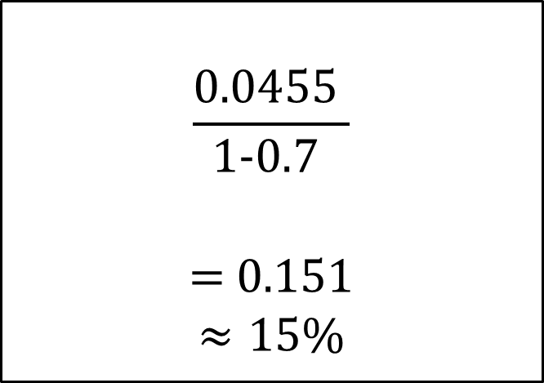
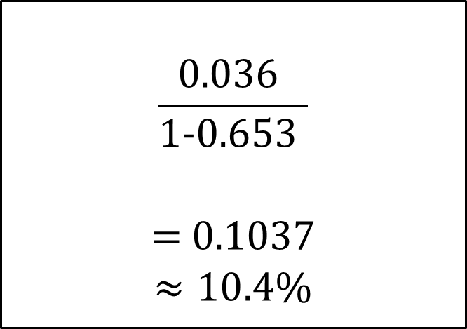

Du Pont System (RETURN ON EQUITY)
$$\frac{Return on Assets}{1−(\frac{Total liabilities}{Total assets})}$$
2013
2012
$$\frac{\text{0.036 }}{\text{1−}\text{0.653 }}$$
= 0.1037
$$≈10.4\%$$
$$\frac{\text{0.0455 }}{\text{1−}\text{0.7 }}$$
= 0.151
$$≈15\%$$

Slide 31
Summary on DuPont analysis
Net Profit Margin
0.65
ROA
3.6 %
ROE
10.4%
2013
1-DEBT RATIO
65.3%
TAT
5.48%
Net Profit Margin
0.83
ROA
4.6%
ROE
15%
2012
TAT
5.44%
1-DEBT RATIO
70%

